Slide 1
Chapter 2
THE DATABASE LANGUAGE SQL

Slide 2
Objectives
Student can write a SQL script.
Student can compose SQL queries using set (and bag) operators, correlated subqueries, aggregation queries.
Student can manipulate proficiently on complex queries

Slide 3
Contents
Integrity constraints
Structure Query Language
DDL
DML
DCL (self studying)
Sub query

Slide 4
REVIEW
Getting
User
Requirement
High-Level
Design
Relational
Database
Schema
Design
Relational DBMS
ER diagram
Relational Database Schema
Figure 4.1: The database modeling and implementation process
Studied:
ER diagram
Relational model
Convert ERD 🡪 Relational model
Now: we learn how to set up a relational database on DBMS

Slide 5
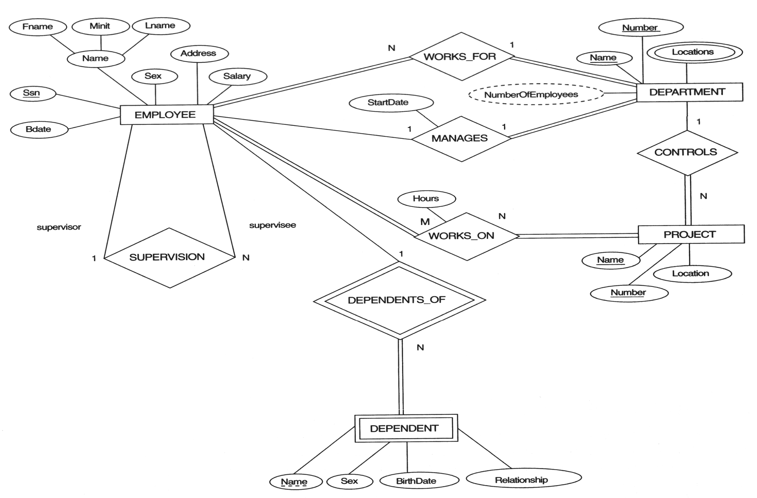
REVIEW – Entity Relationship Diagram
COMPANY Database

Slide 6
Integrity constraints
Purpose: prevent semantic inconsistencies in data
Kinds of integrity constraints:
1. Key Constraints (1 table): Primary key, Candidate key (Unique)
2. Attribute Constraints (1 table): NULL/NOT NULL; CHECK
3. Referential Integrity Constraints (2 tables): FOREIGN KEY
4. Global Constraints (n tables): CHECK or CREATE ASSERTION (self studying)
We will implement these constraints by SQL

Slide 7
SQL Overview
SQL (sequel) is a database language designed for managing data in relational database management systems, and originally based upon relational algebra.
There are many different dialects of SQL
Ansi SQL (or SQL-86), SQL-92, SQL-99
SQL:2003, SQL:2006, SQL:2008, SQL:2009
Transact-SQL (T-SQL) is Microsoft's and Sybase's proprietary extension to SQL.
PL/SQL (Procedural Language/Structured Query Language) is Oracle Corporation's procedural extension for SQL and the Oracle relational database.
Today, SQL is accepted as the standard RDBMS language

Slide 8
Data Definition Language - CREATE
Database schema
Simple syntax: CREATE DATABASE dbname
Full syntax: https://docs.microsoft.com/en-us/sql/database
Relation schema ~ table
CREATE TABLE tableName
(
fieldname1 datatype [integrity_constraints],
fieldname2 datatype [integrity_constraints],
….
)
Full syntax: https://docs.microsoft.com/en-us/sql/table

Slide 9
Các kiểu dữ liệu trong SQL SERVER
INT or INTEGER.
REAL or FLOAT.
CHAR(n) = chuỗi ký tự có độ dài cố định.
VARCHAR(n) = chuỗi ký tự có độ dài thay đổi, và có tối đa n ký tự.
NUMERIC(precision, decimal) = kiểu số với độ dài precision số, và độ chính xác “decimal” đơn vị sau dấu phẩy. NUMERIC(10,2) có thể chứa số lớn đến ±99,999,999.99
DATE = ngày tháng. SQL có định dạng 'yyyy-mm-dd'
TIME = thời gian. SQL có định dạng 'hh:mm:ss[.ss…]'.
DATETIME or TIMESTAMP. SQL có định dạng TIMESTAMP 'yyyy-mm-dd hh:mm:ss[.ss…]'.

Slide 10
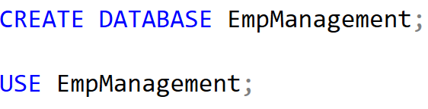
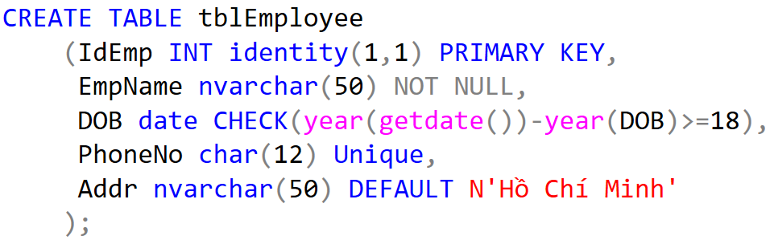
Data Definition Language - Demo

Slide 11
- Diagram in SSMS
-Baitap_Slot1_2_3-4_DLL_SentToStudent
-Bài1_Contrain_Student

Slide 12
Data Definition Language – ALTER, DROP
Used to modify the structure of table, database
Add more columns
ALTER TABLE tableName
ADD columnName datatype [constraint]
Remove columns
ALTER TABLE tableName
DROP column columnName
Modify data type
ALTER TABLE tableName
ALTER coulumn columnName datatype [constraint]

Slide 13
Data Definition Language– ALTER, DROP
Add/remove constraints
ALTER TABLE tablename
ADD CONSTRAINT constraintName PRIMARY KEY
(<attribute list>);
ALTER TABLE tablename
ADD CONSTRAINT constraintName FOREIGN KEY (<attribute list>)
REFERENCES parentTableName (<attribute list>);
ALTER TABLE tablename
ADD CONSTRAINT constraintName CHECK (expressionChecking)
ALTER TABLE tablename
DROP CONSTRAINT constraintName

Slide 14
Data Definition Language– ALTER, DROP
DROP TABLE tableName
DROP DATABASE dbName

Slide 15
Physical Diagram - FUHCompany

Slide 16
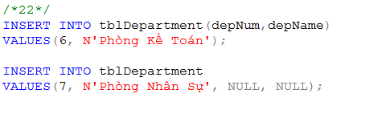
Data Manipulation Language (DML)
Key words: INSERT, UPDATE, DELETE, SELECT
INSERT INTO tableName
VALUES (<value 1>, ... <value n>)
INSERT INTO tableName(<listOfFields>)
VALUES (<value 1>, ... <value m>)
INSERT INTO tableName
SELECT listOfFields FROM another_tableName

Slide 17

Data Manipulation Language (DML)
UPDATE tableName
SET columnName = newValue
[WHERE condition]
Note: newValue could be a value/ an expression/ a SQL statement
Example: Update new salary and depNum for the employee named ‘Mai Duy An’

Slide 18
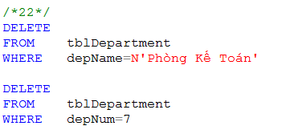
Data Manipulation Language (DML)
DELETE FROM tableName
[WHERE condition]
TRUNCATE TABLE tableName
What is difference between DELETE and TRUNCATE?
What should we do before implement DELETE or TRUNCATE? (referential integrity constraint)
Example:
remove a department named ‘Phòng Kế Toán’
remove a department which depNum is 7

Slide 19
Comparison of Strings
Two strings are equal (=) if they are the same sequence of characters
Other comparisons: <, >, ≤, ≤, ≠
Suppose a=a₁a₂…a_{n} and b=b₁b₂…b_{m} are two strings, the first is less than the second if ∃ k≤min(n,m):
∀i, 1≤i≤k: a_{i} = b_{i}, and
a_{k+1}<b_{k+1}
Example
fodder < foo
bar < bargain

Slide 20
Pattern Matching in SQL
Like or Not Like
Two special characters
% means any sequence of 0 or more characters
_ means any one character
SELECT
FROM
WHERE s LIKE p;
SELECT
FROM
WHERE s NOT LIKE p;

Slide 21


Pattern Matching in SQL
Example 5.1:
Find all employees named as ‘Võ Việt Anh’
Example 5.2
Find all employees whose name is ended at ‘Anh’

Slide 22
Pattern Matching in SQL
USING ESCAPE keyword
SQL allows us to specify any one character we like as the escape character for a single pattern
Example
WHERE s LIKE ‘%20!%%’ ESCAPE !
Or WHERE s LIKE ‘%20@%%’ ESCAPE @
🡺 Matching any s string contains the 20% string
WHERE s LIKE ‘x%%x%’ ESCAPE x
🡺 Matching any s string that begins and ends with the character %

Slide 23
Dates and Times
Dates and times are special data types in SQL
A date constant’s presentation
DATE ‘1948-05-14’
A time constant’s presentation
TIME ‘15:00:02.5’
A combination of dates and times
TIMESTAMP ‘1948-05-14 12:00:00’
Operations on date and time
Arithmetic operations
Comparison operations

Slide 24
Null Values
Null value: special value in SQL
Some interpretations
Value unknown: there is, but I don’t know what it is
Value inapplicable: there is no value that makes sense here
Value withheld: we are not entitled to know the value that belongs here
Null is not a constant
Two rules for operating upon a NULL value in WHERE clause
Arithmetic operators on NULL values will return a NULL value
Comparisons with NULL values will return UNKNOWN

Slide 25
Data Manipulation Language (DML)
SQL Queries and Relational Algebra
SELECT L
FROM R
WHERE C
π_{L}(σ_{C}(R))

Slide 26
T-SQL : Basic Syntax for a simple SELECT queries
SELECT [ ALL | DISTINCT ] [ TOP n [ PERCENT ] ]
* | {column_name | expression [alias],…}
[FROM table]
[WHERE conditions]
SELECT identifies what columns
ALL: Specifies that duplicate rows can appear in the result set. ALL is the default
DISTINCT: Specifies that only unique rows can appear in the result set. Null values are considered equal for the purposes of the DISTINCT keyword
TOP n [ PERCENT ]:Specifies that only the first n rows are to be output from the query result set. n is an integer between 0 and 4294967295. If PERCENT is also specified, only the first n percent of the rows are output from the result set. When specified with PERCENT, n must be an integer between 0 and 100
FROM identifies which table
The WHERE clause follows the FROM clause. Condition: is composed of column names, expressions, constants, and a comparison operator

Slide 27
Common Query in SQL
--1.MovieStar(name, address, gender, birthdate)
--2.Studio(name, address, presC#)
--Khóa chính: name
--3.MovieExec(cert#, name, address, netWorth), Khóa chính: cert#
--4.Movies(title, year, length, genre, studioName, producerC#)
--Khóa chính: (title, year)
--Khóa ngoại:
--studioName tham chiếu đến Studio(name)
--producerC# tham chiếu đến MovieExec(cert#)
--5.StarsIn(movieTitle, movieYear, starName)
--Khóa chính: (movieTitle, movieYear, starName)
--Khóa ngoại:
--movieTitle, movieYear tham chiếu đến Movies(title, year)
--starName tham chiếu đến MovieStar(name)
Listing all r all movies produced by Disney Studios in 1990
SELECT * FROM Movies WHERE studioName = 'Disney' AND year = 1990;

Slide 28

Projection in SQL
Example 3:
Listing all r all movies produced by Disney Studios in 1990 , but produce only the movie title and length:
- SELECT title, length FROM Movies WHERE studioName = ’Disney’ AND year = 1990;
=>

Slide 29

Using alias name in select clause
Example 4: Listing all r all movies produced by Disney Studios in 1990 , but produce a relation with attributes name and duration in place of title and length as follows.
- SELECT title AS name, length AS duration FROM Movies WHERE studioName = ’Disney’ AND year = 1990;
=>

Slide 30
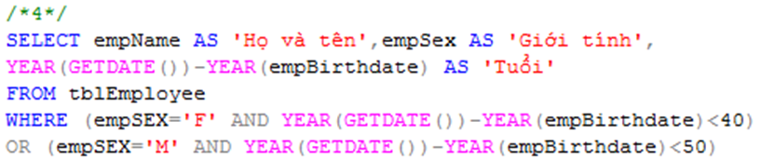
Selection in SQL
Example 4
List all under 40 year-old female or under 50 year-old male employees

Slide 31
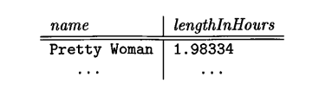
Example 5: : Listing all r all movies produced by Disney Studios in 1990 , but produce a relation with attributes name and duration in place of title and length as follows. And with the length in hours.
-SELECT
title AS name,
CAST(length AS FLOAT) / 60 AS duration
FROM Movies
WHERE studioName = 'Disney Studios' AND year = 1990;
=>

Slide 32
Commonly Used Operators in SQL
- AND, OR, and NOT, In, BETWEEN, LIKE(Tìm kiếm dựa trên mẫu (sử dụng ký tự đại diện như % hoặc _), IS NULL, IS NOT NULL, EXISTS, ANY(So sánh một giá trị với bất kỳ giá trị nào trong tập hợp. ), ALL (So sánh một giá trị với bất kỳ giá trị nào trong tập hợp ), UNION, INTERSECT, MINUS (hoặc EXCEPT)
- =, <>(!=), <=, and >=
SELECT title
FROM Movies
WHERE (year > 1970 OR length < 90) AND studioName = 'MGM';

Slide 33
The Truth-Value UNKNOWN
Truth table for True, False, and Unknown
We can think of TRUE=1; FALSE=0; UNKNOWN=1/2, so
x AND y = MIN(x,y); x OR y = MAX(x, y); NOT x = 1-x
x | y | x AND y | x OR y | NOT x
TRUE | TRUE | TRUE | TRUE | FALSE
TRUE | UNKNOWN | UNKNOWN | TRUE | FALSE
TRUE | FALSE | FALSE | TRUE | FALSE
UNKNOWN | TRUE | UNKNOWN | TRUE | UNKNOWN
UNKNOWN | UNKNOWN | UNKNOWN | UNKNOWN | UNKNOWN
UNKNOWN | FALSE | FALSE | UNKNOWN | UNKNOWN
FALSE | TRUE | FALSE | TRUE | TRUE
FALSE | UNKNOWN | FALSE | UNKNOWN | TRUE
FALSE | FALSE | FALSE | FALSE | TRUE

Slide 34
- SELECT title
FROM Movies
WHERE title LIKE ’Star ---’
- List all movies with a possessive (’s) in their titles. The desired query is :
SELECT title
FROM Movies
WHERE title LIKE ’%’’s%’ ;

Slide 35
Ordering the Output
Presenting the tuples produced by a query in sorted order
The order may be based on the value of any attribute
Syntax
Order by clause follows Where and any other clauses. The ordering is performed on the result of the From, Where, and other clauses, just before Select clause
Using keyword ASC for ascending order and DESC for descending order
SELECT <list of attributes>
FROM <list of tables>
WHERE <conditions>
ORDER BY <list of attributes>

Slide 36
Ordering the Output
Example 7:
Listing all movies produced by Disney Studios in 1990, To display the movies sorted by length and title
- SELECT * FROM Movies WHERE studioName = 'Disney' AND year = 1990 ORDER BY length, title;

Slide 37
Data type:Dates and Times (nhac lai)
DATE : ’ 1948-05-14’
TIME: 23:59:59.9999999
DATETIME: Ngày và giờ
DATETIME2: Lưu ngày và giờ với độ chính xác cao hơn
SMALLDATETIME:.....

Slide 38
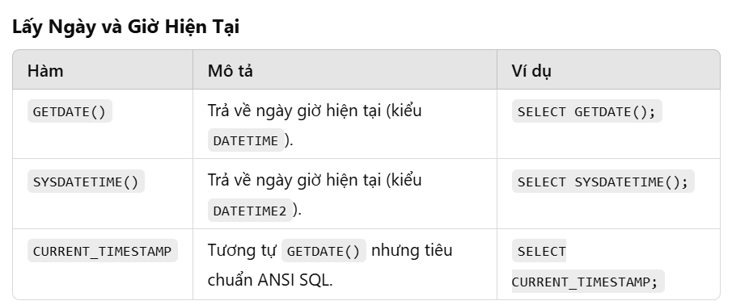

Slide 39
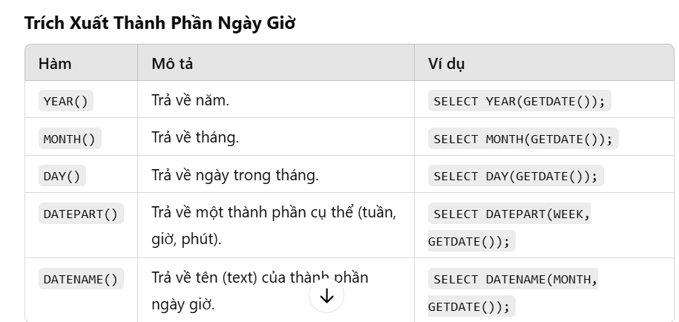

Slide 40
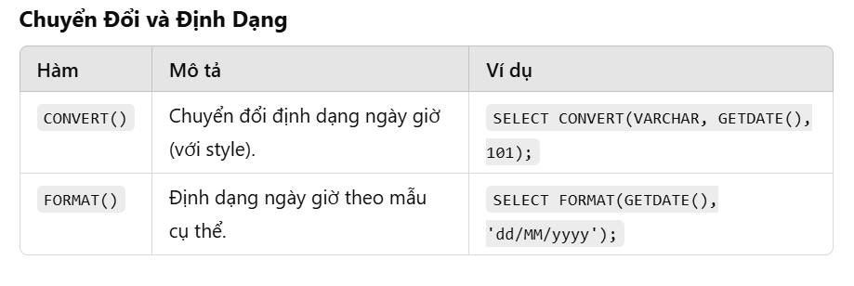

Slide 41
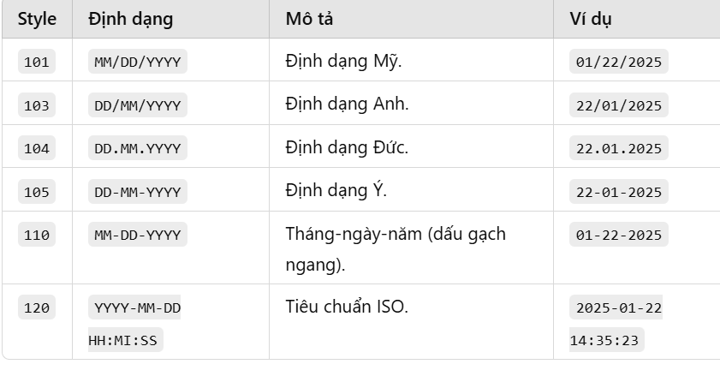

Slide 42
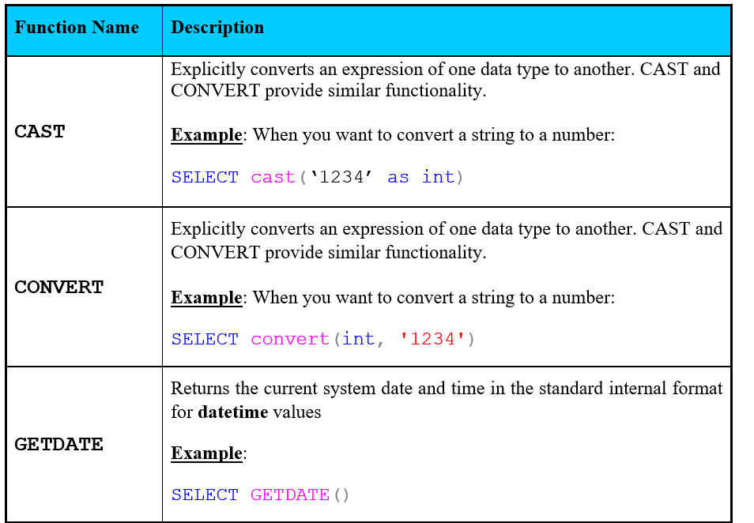
Functions in SQL
CommonFunctions

Slide 43
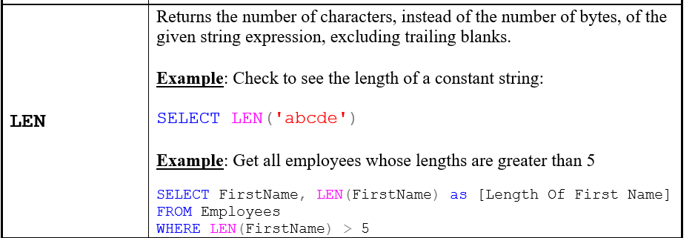
Functions in SQL

Slide 44
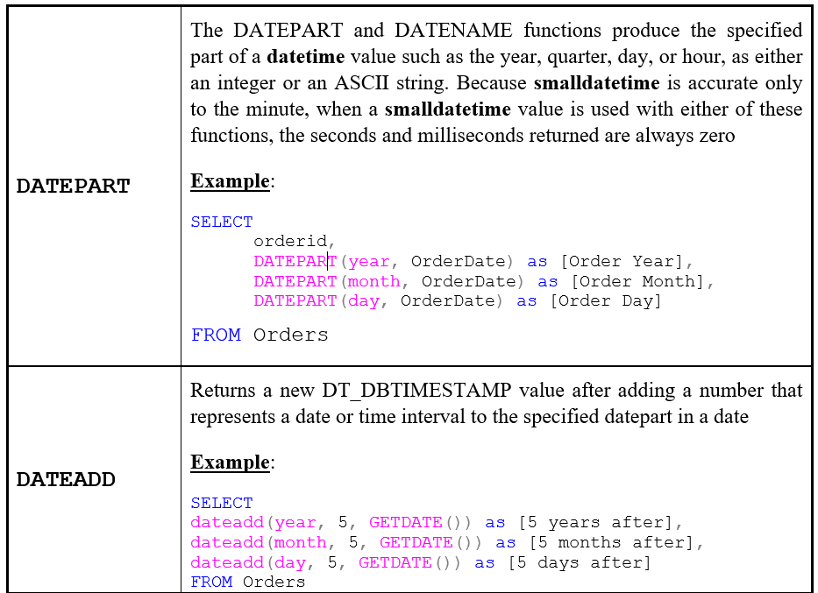
Functions in SQL

Slide 45
6.2 QUERIES INVOLVING MORE THAN ONE RELATION

Slide 46
Queries Involving More Than One Relation
SQL allows we combine two or more relations through joins, products, unions, intersections, and differences

Slide 47
Products and Joins in SQL
When data from more than one table in the database is required, a join condition is used.
Simple way to couple relations: list each relation in the From clause
Other clauses in query can refer to the attributes of any of the relations in the From clause

Slide 48
Products and Joins in SQL
Example 8:
Movies(title, year, length, genre, studioName, producerC#)
MovieExec(name, address, cert#, netWorth)
List all name of the producer of the movie ‘Star Wars’.
SELECT name
FROM Movies, MovieExec
WHERE title = ’Star Wars’ AND producerC# = cert#;

Slide 49
What we do if …
… a query involves several relations, and there are two or more attributes with the same name?

Slide 50
Tuple Variables
We may list a relation R as many times as we need
We use tuple variables to refer to each occurrence of R
List the pairs of names of MovieStar from the MovieStar table who have the same address, with an additional condition that the name of the first star (Starl.name) must be alphabetically smaller than the name of the second star (Star2.name):
SELECT Starl.name, Star2.name
FROM MovieStar Starl, MovieStar Star2
WHERE Starl.address = Star2.address
AND Starl.name < Star2.name;

Slide 51
Disambiguating Attributes
Example 8:
List all name of the producer of the movie Star Wars from the MovieExec
SELECT MovieExec.name
FROM Movies, MovieExec
WHERE Movie.title = ’Star Wars’
AND Movie.producerC# = MovieExec.cert#;

Slide 52
What we do if …
… a query involves two or more tuples from the same relation?
Example 9:
Find movies (Movie Title and Release Year) with multiple different producers
SELECT DISTINCT m1.title AS 'Movie Title', m1.year AS 'Release Year'
FROM Movies m1, Movies m2
WHERE m1.title = m2.title
AND m1.year = m2.year
AND m1.producerC# <> m2.producerC#
GO

Slide 53
Union, Intersection, Difference of Queries
We combine relations using the set operations of relational algebra: union, intersection, and difference
SQL provides corresponding operators with UNION, INTERSECT, and EXCEPT for ∪, ∩, and -, respectively

Slide 54
Union, Intersection, Difference of Queries
Example 10.1
find movies with :
--The movie title starts with the letter "H.“ orThe movie duration is greater than 120 minutes.
SELECT * FROM Movies WHERE title LIKE 'H%’
UNION
SELECT * FROM Movies WHERE length > 120

Slide 55
Union, Intersection, Difference of Queries
To find the movies that are in the Movies table but not in the StarsIn table (i.e., movies that do not have any stars involved)
Example 10.2
Find all those normal employees, that is who do not supervise any other employees
SELECT title, year FROM Movies
EXCEPT
SELECT movieTitle, movieYear FROM StarsIn;

Slide 56
Union, Intersection, Difference of Queries
Example 10.3
To find all the stars who have appeared in movies produced in 2023 and 2024.
SELECT starName
FROM StarsIn
WHERE movieYear = 2023
INTERSECT
SELECT starName
FROM StarsIn
WHERE movieYear = 2024;

Slide 57
6.3 SUB QUERIES

Slide 58
Sub-queries
One query can be used to help in the evaluation of another
A query that is part of another is called a sub-query
Sub-queries return a single constant, this constant can be compared with another value in a WHERE clause
Sub-queries return relations, that can be used in WHERE clause
Sub-queries can appear in FROM clauses, followed by a tuple variable

Slide 59
Sub-queries that Produce Scalar Values
An atomic value that can appear as one component of a tuple is referred to as a scalar
Let’s compare two queries for the same request

Slide 60
Sub-queries that Produce Scalar Values
Example 7:
To find all the stars who have appeared in horror movies.
SELECT s.starName FROM StarsIn s, Movies m
WHERE s.movieTitle = m.title AND s.movieYear = m.year AND m.genre LIKE '%Horror%';
SELECT starName FROM StarsIn
WHERE movieTitle IN ( SELECT title FROM Movies WHERE genre LIKE '%Horror%' );

Slide 61
Sub-queries that Produce Scalar Values
Example 11: Khác nhau gì
SELECT title, year FROM Movies WHERE producerC# = ( SELECT cert# FROM MovieExec WHERE name = 'A’ );
SELECT title, year FROM Movies WHERE producerC# IN ( SELECT cert# FROM MovieExec WHERE name = 'A' );
Notes:
--Truy vấn con (SELECT cert# FROM MovieExec WHERE name = 'A') phải trả về đúng một giá trịnhieeuf hơn sữ bị sai

Slide 62
Sub-queries that Produce Scalar Values
Example 11: Giống nhau
SELECT starName
FROM StarsIn
WHERE movieTitle IN (
SELECT title
FROM Movies
WHERE genre LIKE '%Horror%'
);
SELECT starName
FROM StarsIn
WHERE movieTitle = any (
SELECT title
FROM Movies
WHERE genre LIKE '%Horror%'
);

Slide 63
Conditions Involving Relations
Some SQL operators can be applied to a relation R and produce a bool result
(EXISTS R = True) ⇔ R is not empty
(s IN R = True) ⇔ s is equal to one of the values of R
(s > ALL R = True) ⇔ s is greater than every values in unary R
(s > ANY R = True) ⇔ s is greater than at least one value in unary R

Slide 64
Conditions Involving Tuples
A tuple in SQL is represented by a list of scalar values between ()
If a tuple t has the same number of components as a relation R, then we may compare t and R with IN, ANY, ALL

Slide 65
Correlated Sub-queries
To now, sub-queries can be evaluated once and for all, the result used in a higher-level query
But, some sub-queries are required to be evaluated many times
That kind of sub-queries is called correlated sub-query
Note: Scoping rules for names

Slide 66
Correlated Sub-queries
Another example:
Find the titles that have been used for two or movies
SELECT title
FROM Movies Old
WHERE year < ANY
(SELECT year
FROM Movies
WHERE title =Old.title)

Slide 67
Sub-queries in FROM Clauses
In a FROM list we can use a parenthesized sub-query
We must give it a tuple-variable alias
Example: Find the employees of Phòng Phần mềm trong nước
SELECT *
FROM tblEmployee e, (SELECT depNum
FROM tblDepartment
WHERE depName=N'Phòng phần mềm trong nước') d
WHERE e.depNum=d.depNum

Slide 68
SQL Join Expressions
SQL Join Expressions can be stand as a query itself or can be used as sub-queries in FROM clauses
Cross Join in SQL= Cartesian Product
Syntax: R CROSS JOIN S;
Meaning: Each tuple of R connects to each tuple of S
SELECT * FROM movies CROSS JOIN MoviesExec;
SELECT * FROM movies , MoviesExec;

Slide 69
Theta Join with ON keyword
Systax: R JOIN S ON R.A=S.A;
Meaning: Each tuple of R connects to those tuples of S, which satisfy the condition after ON keyword
SELECT m.title, m.year, me.name, me.netWorth
FROM Movies m
JOIN MovieExec me ON m.producerC# = me.cert#;

Slide 70
SQL Join Expression
More Example

Slide 71
Natural Joins
A natural join differs from a theta-join in that:
The join condition: all pairs of attributes from the two relations having a common name are equated, and there are no other condition
One of each pair of equated attributes is projected out
Syntax : Table1 NATURAL JOIN Table2
Microsoft SQL SERVER DONOT SUPPORT NATURAL JOINS AT ALL
-- Kết nối tựu nhiên
SELECT m.*, s.*
FROM Movies m
JOIN Studio s ON m.studioName = s.name;

Slide 72
-- Kết nối tự nhiên, hoặc có thể viết đầy đủ Inner joint
--SELECT m.title, m.year, s.name, s.address
SELECT m.title, m.year, s.name, s.address
FROM Movies m
INNER JOIN Studio s
ON m.studioName = s.name;

Slide 73
Outer Joins
The outer join is a way to augment the result of join by the dangling tuples, padded with null values
When padding dangling tuples from both of its arguments, we use full outer join
When padding from left/right side, we use left outer join/right outer join

Slide 74
Outer joins
Example 17.1:
--Lấy danh sách tất cả các bộ phim và tên studio sản xuất,
--kể cả những phim không có studio hoặc studio không có phim nào
SELECT
m.title AS Movie_Title,
m.year AS Movie_Year,
s.name AS Studio_Name
FROM Movies m
FULL OUTER JOIN Studio s
ON m.studioName = s.name;

Slide 75
Left joins
Example 17.2:
Lấy danh sách tất cả các bộ phim cùng với tên studio sản xuất, kể cả những phim chưa có studio.
SELECT
m.title AS Movie_Title,
m.year AS Movie_Year,
s.name AS Studio_Name
FROM Movies m
LEFT JOIN Studio s
ON m.studioName = s.name;

Slide 76
Right joint
--Lấy danh sách tất cả các studio cùng với các bộ phim mà họ sản xuất,
--kể cả những studio chưa có phim nào.
SELECT
m.title AS Movie_Title,
m.year AS Movie_Year,
s.name AS Studio_Name
FROM Movies m
RIGHT JOIN Studio s
ON m.studioName = s.name;

Slide 77
6.4 Full-Relation Operations
Study some operations that acts on relations as whole, rather than on tuples individually

Slide 78
Eliminating Duplicates
A relation, being a set, cannot have more than one copy of any given tuple
But, the SQL response to a query may list the same tuple several times, that is, SELECT preserves duplicates as a default
So, by DISTINCT we can eliminate a duplicates from SQL relations

Slide 79
Eliminating Duplicates
Example 17.3:
--Lấy danh sách tên studio duy nhất (Studio.name) đã sản xuất phim
--cùng với địa chỉ của studio đó.
SELECT DISTINCT s.name, s.address
FROM Movies m
INNER JOIN Studio s
ON m.studioName = s.name;

Slide 80
Duplicates in Unions, Intersections, and Differences
Set operations on relations will eliminate duplicates automatically
Use ALL keyword after Union, Intersect, and Except to prevent elimination of duplicates
Syntax:
R UNION ALL S;
R INTERSECT ALL S;
R EXCEPT ALL S;

Slide 81
-- Phép giao
--Lấy danh sách những người vừa là diễn viên vừa là đạo diễn (cùng xuất hiện trong cả hai bảng).
SELECT name FROM MovieStar
INTERSECT
SELECT name FROM MovieExec;
--Lấy danh sách tất cả tên diễn viên và đạo diễn (không trùng nhau).
SELECT name FROM MovieStar
UNION
SELECT name FROM MovieExec;
--EXCEPT - Lấy phần hiệu của hai tập dữ liệu
--Lấy danh sách những người là diễn viên nhưng không phải đạo diễn.
SELECT name FROM MovieStar
EXCEPT
SELECT name FROM MovieExec;

Slide 82
SELECT name FROM MovieStar
UNION all
SELECT name FROM MovieExec;
Notes:
Kết quả sẽ bao gồm tất cả các product_id từ bảng Products và Sales, kể cả những giá trị trùng lặp.

Slide 83
Grouping and Aggregation in SQL
Grouping operator partitions the tuples of relation into groups, based on the values of tuples in one or more attributes
After grouping the tuples of relation, we are able to aggregate certain other columns of relation
We use GROUP BY clause in SELECT statement

Slide 84
Aggregation Operators
Five aggregation operators
SUM acts on single numeric column
AVG acts on single numeric column
MIN acts on single numeric column
MAX acts on single numeric column
COUNT act on one or more columns or all of columns
Eliminating duplicates from the column before applying the aggregation by DISTINCT keyword

Slide 85
Aggregation Operators
--Tính tổng độ dài của tất cả các bộ phim trong cơ sở dữ liệu.
SELECT studioName, SUM(length) AS totalLength
FROM Movies
GROUP BY studioName;

Slide 86
Grouping
To partition the tuples of relation into groups
Syntax
SELECT <list of attributes>
FROM <list of tables>
WHERE <condition>
GROUP BY <list of attributes>

Slide 87
Grouping
Example 19.1:
--Đếm số lượng bộ phim do mỗi nhà sản xuất (MovieExec) sản xuất.
SELECT producerC#, COUNT(*) AS numberOfMovies
FROM Movies
GROUP BY producerC#
ORDER BY COUNT(*) ASC ;

Slide 88
Grouping
There are two kinds of terms in SELECT clause
Aggregations, that applied to an attribute or expression involving attributes
Grouping Attributes, that appear in GROUP BY clause
A query with GROUP BY is interpreted as follow:
Evaluate the relation R expressed by the FROM and WHERE clauses
Group the tuples of R according to the attributes in GROUP BY clause
Produce as a result the attributes and aggregation of the SELECT clause

Slide 89
Grouping, Aggregation, and Nulls
When tuples have nulls, there are some rules:
The value NULL is ignored in any aggregation
Count(*): a number of tuples in a relation
Count(A): a number of tuples with non-NULL values for A attribute
NULL is treated as an ordinary value when forming groups
The count of empty bag is 0, other aggregation of empty bag is NULL

Slide 90
Grouping, Aggregation, and Nulls
Example: Suppose R(A,B) as followed
A | B
NULL | NULL
The result of query
SELECT A, count(B)
FROM R
GROUP BY A;
is one tuple (NULL,0)
The result of query
SELECT A, sum(B)
FROM R
GROUP BY A;
is one tuple (NULL,NULL)

Slide 91
Considerations …
If we want to apply conditions to tuples of relations, we put those conditions in WHERE clause
If we want to apply conditions to groups of tuples after grouping, those conditions are based on some aggregations, how can we do?
In that case, we follow the GROUP BY clause with a HAVING clause

Slide 92
HAVING clause
Syntax:
SELECT <list of attributes>
FROM <list of tables>
WHERE <conditions on tuples>
GROUP BY <list of attributes>
HAVING <conditions on groups>

Slide 93
HAVING clause
--Tìm các diễn viên (MovieStar) đã đóng từ 2 bộ phim trở lên,
--tức là có ít nhất 2 dòng dữ liệu trong bảng StarsIn.
SELECT starName, COUNT(*) AS SoLuongPhim
FROM StarsIn
GROUP BY starName
HAVING COUNT(*) >= 2;

Slide 94
HAVING clause
Some rules about HAVING clause
An aggregation in a HAVING clause applies only to the tuples of the group being tested
Any attribute of relations in the FROM clause may be aggregated in the HAVING clause, but only those attributes that are in the GROUP BY list may appear un-aggregated in the HAVING clause (the same rule as for the SELECT clause)

